Slide 1
Initiative
Food Trade Control Section
Preparation
Control Of Food From The Source
Country: Sri Lanka
Food Safety Department

Slide 2
Control of Food From The Source
01
Definition Control Of Food From The Source
An activity carried out by government agencies or authorities to protect consumers and ensure the safety of all food during production, handling, storage, processing and distribution, ensuring their nutritional value and suitability for human consumption; and ensuring their conformity with quality and safety requirements،

Slide 3
Objectives
02
Assuring Food Safety and Quality.
Protecting public health by reducing the risk of foodborne illness.
Minimize the rejection of non-conforming foods.
To overcome the difficulties and obstacles facing the export of food from exporting countries
To sensitize exporters to the import requirements in force in the UAE.
Fast release of food shipments.

Slide 4
Control of food from the source
03
Control Of Food From The Source should cover :
food produced, processed including importation.
Halal certificates and health certificates issued .
Laboratory analysis of food

Slide 5
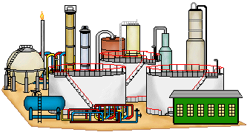
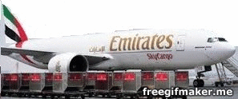
Control of food from the source
04
country of origin
1
2
3
4
Factory
Halal
lab tests
Issuing certificates
Inspection
Port Of Entry
Release

Slide 6
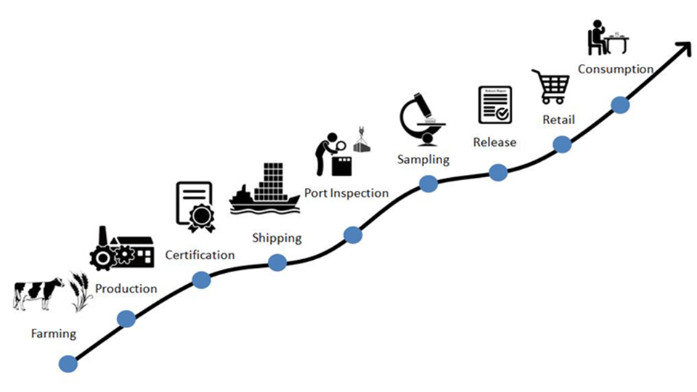
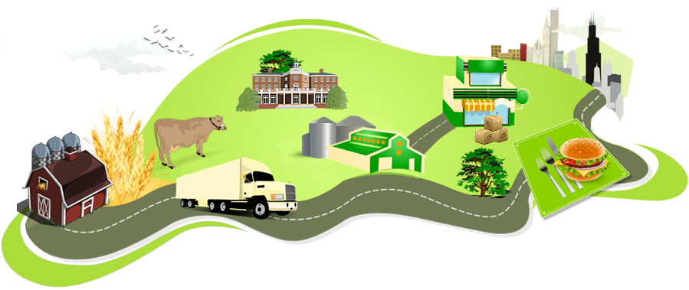
(Farm to Fork)
Food Chain
05

Slide 7
Target countries
06
India الهند
UK المملكة المتحدة
Netherlandsهولندا
Italy إيطاليا
Australia أستراليا
USAالولايات المتحدة الأمريكية
Egypt مصر
Japan اليابان
Canada كندا
Spain أسبانيا
Pakistan باكستان
Philippine الفلبين
Thailand تايلاند
Malaysia ماليزيا
Sri Lanka سيريلانكا

Slide 8
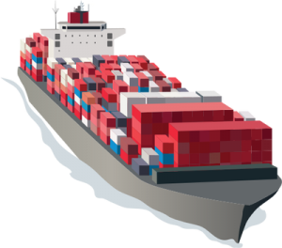
Sri Lanka-Statistic 2016
07

Slide 9
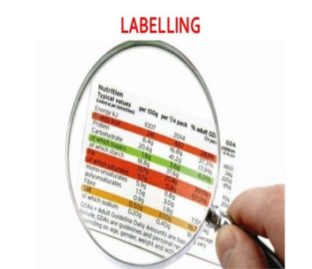
08
Sri Lanka -2016
Sri Lanka statistics include the following
Results of samples
Label contraventions
Certificates contraventions

Slide 10
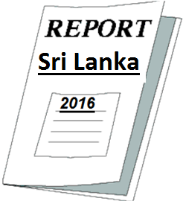
Sri Lanka -Statistic 2016 Baseline
09
No of imported consignments | No- of Contaniers | No of items imported | Total item contraventions | Quantity food imported .tons | Destruction Quantity tons | Total samples collected | Total samples Unfit | Undertaking Certificate
6,790 | 7,359 | 40,189 | 1,759 | 43,108 | 3 | 143 | 12 | 74
 |  |  | 4.4% |  | 0.006% |  | 8.4%
Results of samples
Number of Unfit samples )12)( Percentage(% 8.4).
label contravention
Number of label contravention( 1,759)
Percentage(4.4 %)
Certificates contravention
Number of Certificates contravention(991)
Percentage(56 %)

Slide 11
Sri Lanka- 2016
10

Slide 12
Sri Lanka- Group Contravention 2016
11
Group Contravention | Total item contraventions | total imported items
Label contraventions | 756 | 40,189
Certificates contraventions | 991
Samples results contraventions | 12
Total | 1,759 | 40,189
 | 4.4%

Slide 13
Sri Lanka - Group Contravention 2016
12

Slide 14
Sri Lanka - Group Contravention 2016
13
Label contraventions - How to solve it?
Comply with standards of United Arab Emirates for labeling requirement
Apply label assessment in FIRS system of Dubai Municipality
by the local importer
Contraventions Can be reduced

Slide 15
Sri Lanka - Group Contravention 2016
14
2. Certificates contraventions - How to solve it?
Comply with health certification requirements of UAE.
Submit health certificates with shipment on time.
Provide a list of health certificates bodies of Sri lanka
Certificate verification system if available .
Contraventions Can be reduced

Slide 16
Sri Lanka - Group Contravention 2016
15
3. Samples results contraventions - How to solve it?
Comply with food standards of United Arab Emirates.
Contraventions Can be reduced

Slide 17
16
Sri Lanka - Group Contravention 2016
Sr No | Contravention | No of Requests | No Of Items | Total Weight
1 | Health Certificate copy only submitted | 42 | 177 | 236,527
2 | Country of origin not declared in Arabic | 46 | 131 | 264,653
3 | Health Certificate not submitted | 32 | 114 | 120,998
4 | Health certificate does not comply with regulation | 16 | 89 | 54,222
5 | Fish not fed with pork protein or its derivatives Certificate not submitted | 26 | 87 | 21,081
6 | Arabic Label Is Not Declared | 45 | 80 | 391,518
7 | Product name is not declared in Arabic | 37 | 80 | 459,538
8 | Item is not available for inspection | 1 | 43 | 260
9 | Organic Certificate not submitted | 11 | 41 | 13,788
10 | GMO free certificate not submitted | 8 | 33 | 20,287
11 | Ingredients are not declared | 4 | 18 | 1,025
12 | Exceeding shelf life | 14 | 17 | 283,314
13 | Medical claim declared | 2 | 16 | 4,837
14 | Production date is not declared | 4 | 11 | 3,080
15 | Unspecified food ingredients | 3 | 8 | 772
16 | Label is on easily removable sticker | 6 | 8 | 98,235
17 | Laboratory result is unfit | 7 | 7 | 32,774
19 | Country of origin is not declared | 5 | 7 | 1,099
20 | Halal Certificate not Submitted | 3 | 7 | 436

Slide 18
Sri Lanka- Group Contravention 2016
17

Slide 19
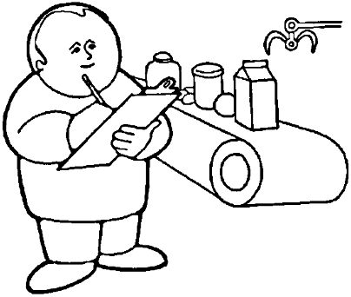
Sri Lanka -Statistic 2016
15
Inspection results / Sampling results.

Slide 20
Sri Lanka - Statistic 2016
16
Sri Lanka Position ....
1
12
....
7
8
9
10
11
2
3
4
5
6

Slide 21
S/N | Country of Origin | Number of imported shipments
1 | India | 71,633
2 | Oman | 48,387
3 | Pakistan | 19,739
4 | Egypt | 14,164
5 | Netherlands | 13,451
6 | United States | 11,859
7 | Australia | 11,528
8 | China | 8,950
9 | Iran | 8,642
10 | Thailand | 8,177
11 | United Kingdom | 8,001
12 | Turkey | 7,471
13 | Kenya | 6,892
14 | Ethiopia | 6,842
15 | Italy | 6,791
16 | Sri Lanka | 6,790
17 | France | 6,444
18 | South Africa | 6,374
19 | Spain | 6,169
20 | Brazil | 4,060
2 | Philippines | 3,584
26 | Malaysia | 3,577

Slide 22
Number of imported shipments
18

Slide 23
S/N | Country of Origin | Number of imported items
1 | India | 283,289
2 | United Kingdom | 255,509
3 | Oman | 183,340
4 | Netherlands | 159,483
5 | France | 130,518
6 | United States | 115,238
7 | Thailand | 74,564
8 | Italy | 58,683
9 | Australia | 55,498
10 | Pakistan | 53,585
11 | Egypt | 41,738
12 | Sri Lanka | 40,189
13 | Turkey | 32,826
14 | Philippines | 29,010
15 | Kenya | 27,553
16 | Lebanon | 26,327
17 | South Africa | 25,735
18 | Iran | 22,284
19 | Germany | 20,332
20 | Spain | 19,421
21 | China | 18,821
22 | Japan | 18,335
23 | Brazil | 16,457
24 | Bangladesh | 14,408
25 | Belgium | 14,283

Slide 24
Number of imported items
20

Slide 25
S/N | Country of Origin | Quantity of food imported per kg
1 | India | 1,793,132,964
2 | Pakistan | 470,655,669
3 | Canada | 324,311,693
4 | China | 300,025,844
5 | Iran | 290,867,664
6 | South Africa | 254,361,714
7 | United States | 225,064,921
8 | Egypt | 216,247,873
9 | Australia | 215,124,761
10 | Oman | 210,297,163
11 | Turkey | 189,231,307
12 | Brazil | 173,766,044
13 | Romania | 173,212,856
14 | New Zealand | 156,385,541
15 | Thailand | 146,815,450
16 | Philippines | 132,700,772
17 | Netherlands | 123,886,617
18 | Italy | 112,002,999
19 | France | 110,214,362
20 | Malaysia | 107,835,283
21 | Spain | 102,604,765
22 | Vietnam | 84,271,555
23 | Ukraine | 77,987,633
24 | Indonesia | 76,766,698
25 | Germany | 73,422,311
26 | Lebanon | 69,978,465
27 | Kenya | 68,099,446
28 | Lithuania | 67,131,764
29 | Saudi Arabia | 61,924,434
30 | Argentina | 60,045,809
31 | United Kingdom | 52,307,265
32 | Myanmar | 49,918,145
33 | Ecuador | 46,862,606
34 | Sri Lanka | 43,108,506

Slide 26
Quantity of food imported per kg
22

Slide 27
S/N | Country of Origin | Contravention
1 | United Kingdom | 96,578
2 | France | 90,697
3 | India | 61,053
4 | United States | 40,292
5 | Italy | 32,446
6 | Australia | 23,958
7 | Japan | 19,220
8 | Netherlands | 13,613
9 | Ireland | 11,849
10 | Germany | 10,657
11 | Brazil | 9,840
12 | Belgium | 9,120
13 | Pakistan | 8,765
14 | Kenya | 8,479
15 | New Zealand | 8,012
16 | Turkey | 7,783
17 | South Africa | 7,594
18 | Oman | 6,946
19 | Philippines | 6,206
20 | Thailand | 5,529
21 | Spain | 5,159
22 | Greece | 5,097
23 | Canada | 3,894
24 | China | 3,825
25 | Saudi Arabia | 3,701
26 | Egypt | 3,103
27 | Iran | 3,059
28 | Malaysia | 3,013
29 | Norway | 2,708
30 | Singapore | 2,610
31 | Ukraine | 2,324
32 | Korea(South) | 2,132
33 | Switzerland | 2,050
34 | Austria | 1,995
35 | Poland | 1,931
36 | Lebanon | 1,927
37 | Argentina | 1,834
38 | Sri Lanka | 1,803
Country - Contravention

Slide 28
Country - Contravention
24

Slide 29
The required documents
26
Required documents from country of origin
Health Certificate from Authorized Government Entity
Halal Certificate ( For the meat, poultry & its products)
Packing list
Other certificate for specific consignment:
Pork- free diet certificate for Farmed Fish and Seafood's and its products
Organic Certificate (If claimed)
GMO free Certificate (If Claimed)
Other Certificate as per the Circular

Slide 30
27
Health Certificate
What details must be declared in the Health certificate?
Details of the food shipment:
Quantity, weight, description
Airway Bill Number or Container Numbers
Invoice Number
Certificate Serial Number
Date of Issuance
The statement: “Fit for human consumption.”

Slide 31
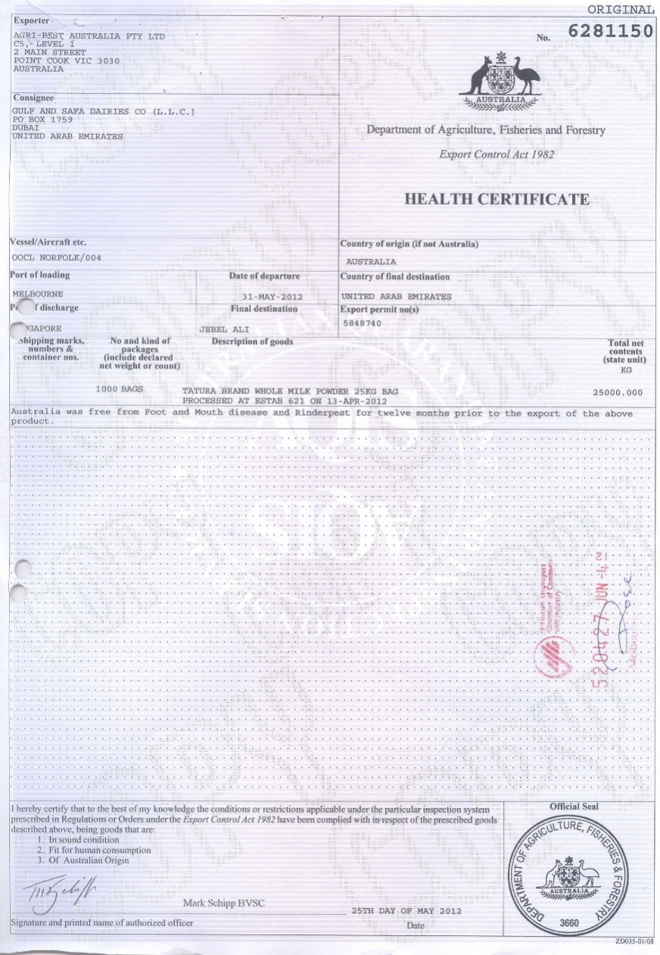
28
Health Certificate
Consignee name
Certificate Serial/issuing date
Food Items description
Quantity, weight.
Compliance Statement

Slide 32
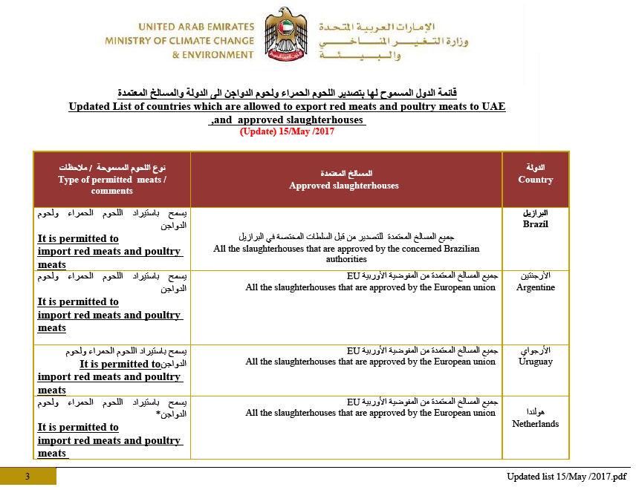
Halal Certificate – issued by
26
Approved Islamic Association List
http://www.moccae.gov.ae/

Slide 33
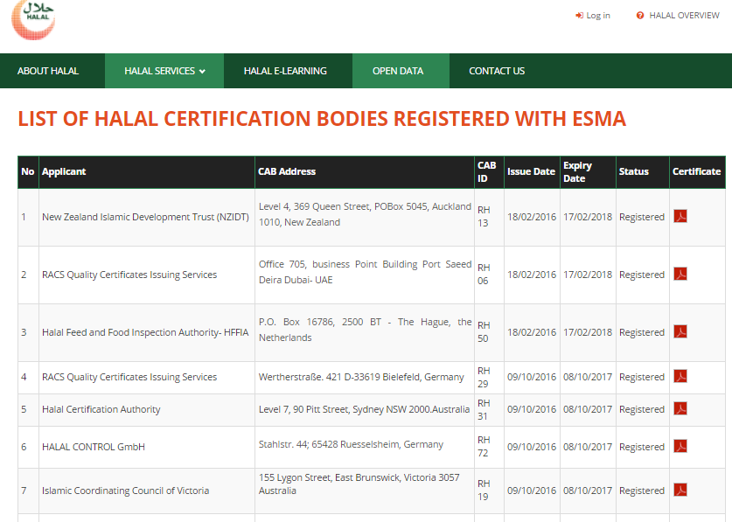
Halal Certificate – issued by
27
Approved Islamic Association List
http://halal.ae/en-us/Open-Data/Pages/LIST-OF-HALAL-CERTIFICATION-BODIES-REGISTERED-WITH-ESMA.aspx

Slide 34
Recommendations Requirements :
33
Organic certificates
Issuing certificates for organic products from the accredited bodies of the Ministry of Environment and Climate Change. Which can be find the Ministry of Environment and Climate Change website.
http://www.moccae.gov.ae/ar/laws-and-legislations/ministerial-decrees/general-ministerial-decrees.aspx#page=1

Slide 35
Recommendations Requirements :
34
GMO Free Certificate.
The original certificate must be submitted to the inspector at the entry port during the inspection of the consignment
Certificate must be issued by the authorized body.

Slide 36
Recommendations Requirements :
35
2. Lab tests
Analysis of food products by laboratory before exportation. To ensure the validity of food for human consumption

Slide 37
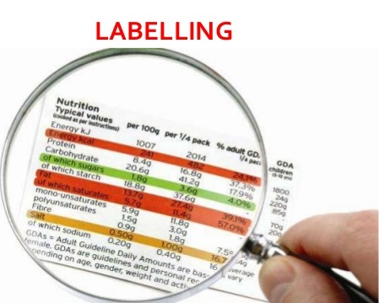
Recommendations Requirements :
36
3. Label contraventions
label assessment must be for imported products . To ensure that the food label conforms to the approved standard (UAE)

Slide 38
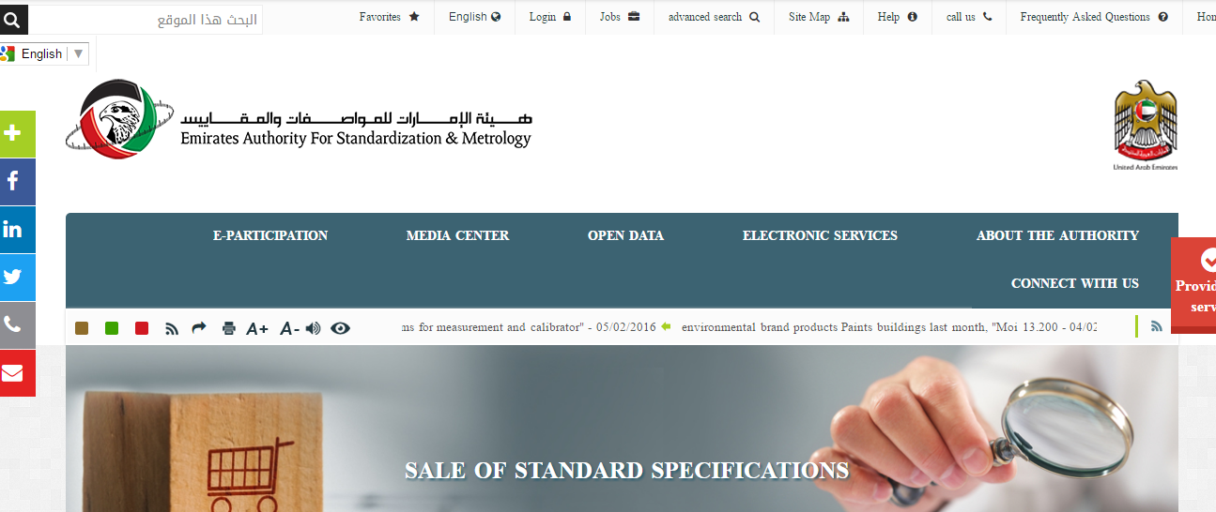
Requirements :
37
Emirates Authority for Standardization and Metrology
http://www.esma.gov.ae/ar-ae/Services/Pages/Purchase-Standards.aspx

Slide 39
Requirements :
38
4. List of authorized body to issue health certificates
Name of authorized body .
Contact Number .
E-mail .
standard format health certificate

Slide 40
Requirements :
31
5. Awareness Of Exporters:

Slide 41
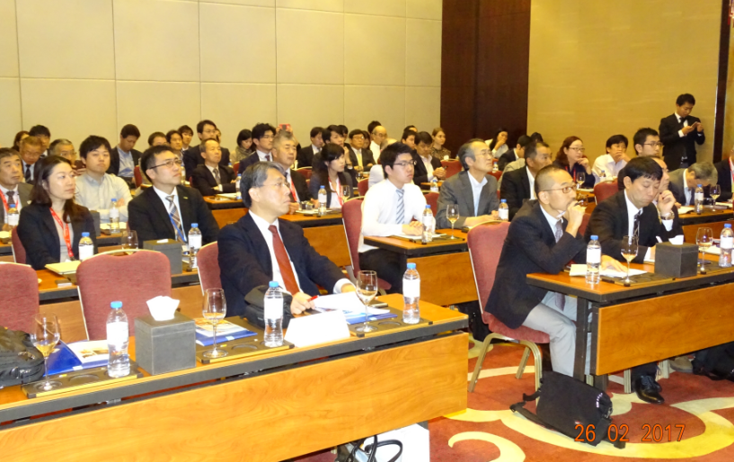
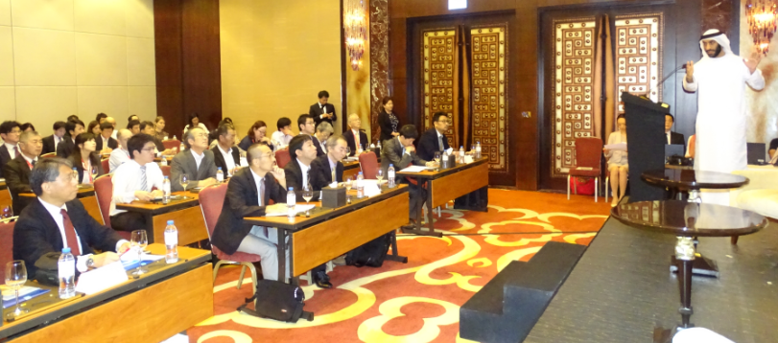
Requirements :
39
5. Awareness Of Exporters:

Slide 42
34
Requirements
5. Awareness Of Exporters:

Slide 43
Requirements :
40
6. Provide Us Plan To Reduce The contravention
contravention

Slide 44
Performance indicators
41
Performance indicators :
Results of samples
Sampling results (KPI) = Number of Unfit samples ÷ Total number of samples collected X 100.

Slide 45
Performance indicators
41
Performance indicators :
Label contraventions
Label contraventions (KPI) = Number of contraventions ÷ Total number of imported items X 100.

Slide 46
Performance indicators
41
Performance indicators :
Certificates contraventions
Certificates contraventions (KPI) = Number of Certificates contraventions ÷ Total number of imported items X 100.

Slide 47
Study results and corrective actions
42
Study results and corrective actions :
Samples Results (KPI)
Contravention Label Results (KPI)
Certificate contraventions Results (KPI)

Slide 48
Main Concerns
43
Documentation should available (Health, Halal, GMO, Fish, Organic , standard format).
All food items contraventions (as explained in the excel sheet)
Proved list of competent authorities of Sri Lanka (contact number, email, contact name,…)
Verification provisions (if available ).
Feedback and time line of the development ( possible period and plan)

Slide 49
Communication
44
S/N | Name |  | Contact number | E-mail
1 | Mr.Chathura Weerasekera Consulate General |  | 04-3989880 04-3986535 | condubai@slcgdxb.ae
2 | Mr. Chinthaka Samarasingha Protocol Officer |  |  | chinthaka@slcgdxb.ae
Dubai Municipality
1 | Mr.Ahmed khalifa | 042064280 0503455153 |  | AMKALIFA@dm.gov.ae
2 | Ahmed Abouraia | 0558290079 042064227 |  | amabouraia@dm.gov.ae
3 | Javeed Ahmed | 0505956163 042064205 |  | JAVEEDAA@dm.gov.ae

